Slide 1

Winthrop
Revere Street Reconstruction Project
September 20, 2022
Project Update
Presented by:
Andrew Valcovic, PE
CHA Consulting, Inc.

Slide 2
Agenda
Project Overview
History
Goals
Proposed Improvements
Bicycle Accommodations/ Parking impacts
Project Walk-through
Bus Stops
Next Steps
Questions/ Comments?

Slide 3
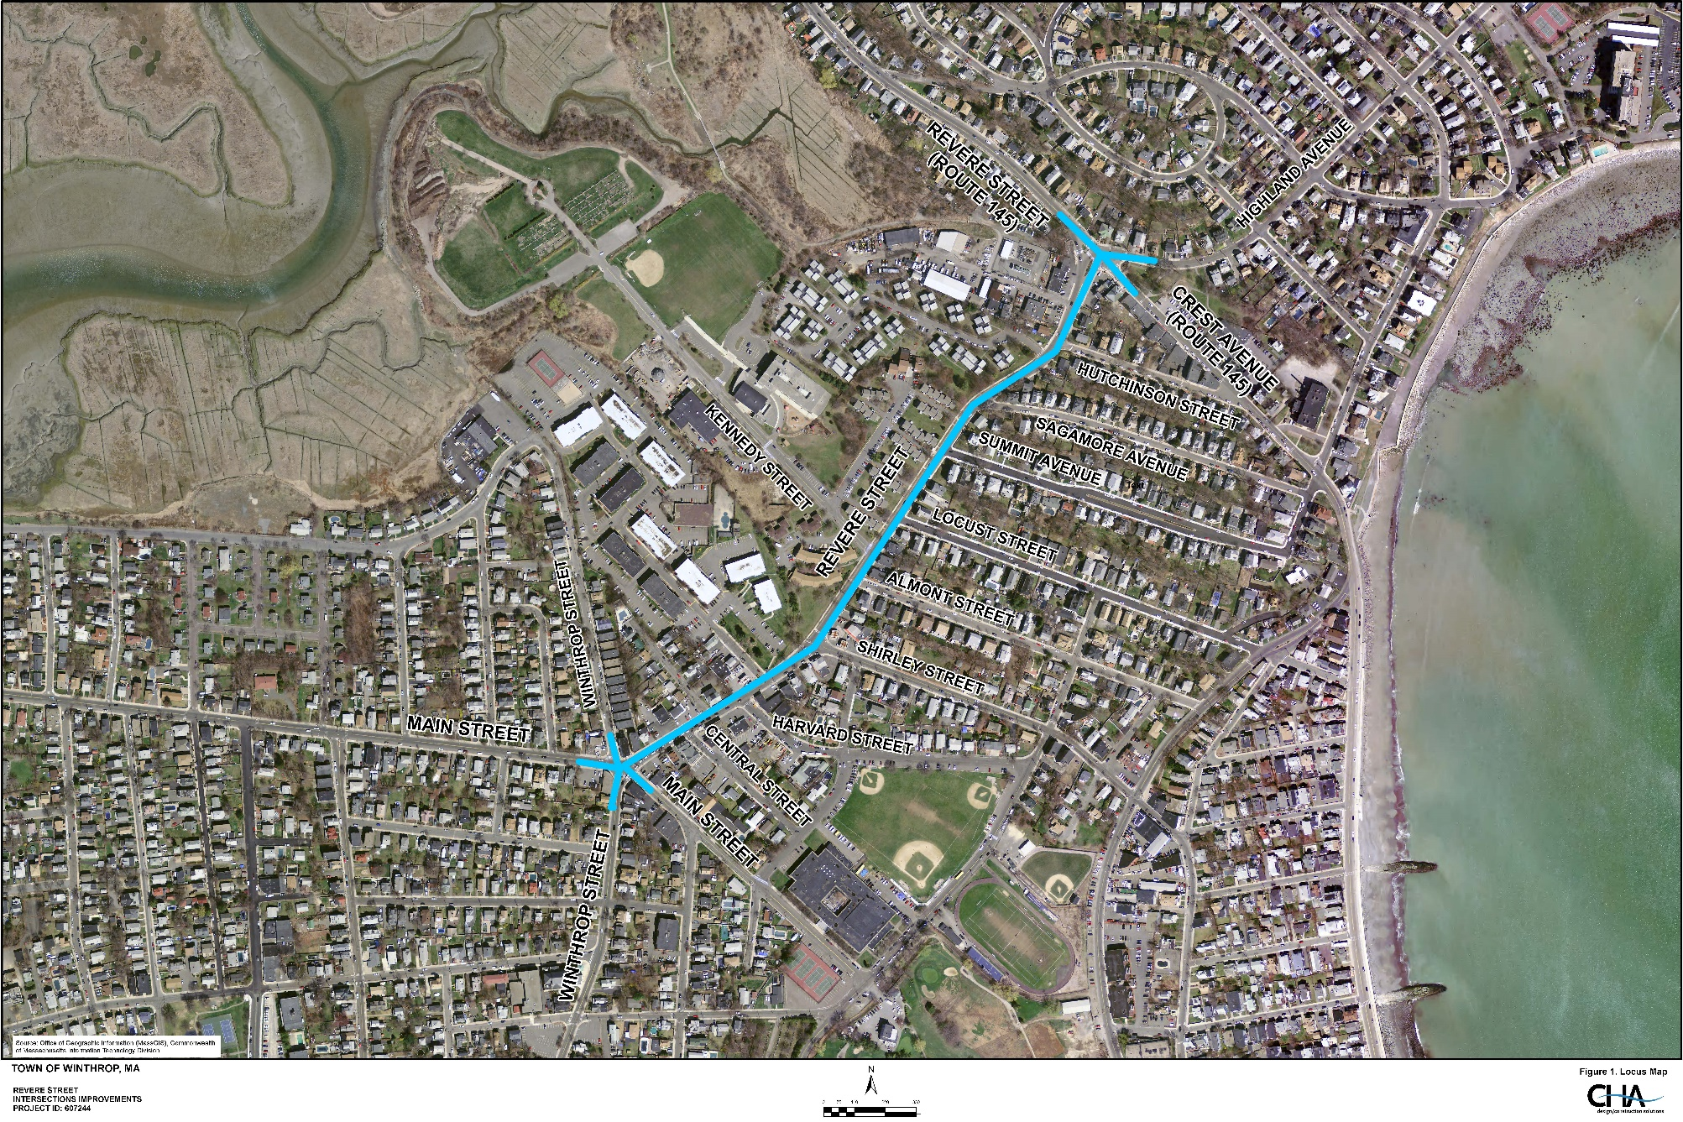
Project Overview
Revere Street
From Magee’s Corner to Crest Avenue
Includes Signals at each end of the project
0.5 mile long

Slide 4
Project Overview
Average Daily Traffic = 15,100 vehicles per day
Vehicle Speeds = 25-30 MPH
(85th Percentile)
Land use
Primarily residential
Commercial Areas
Elementary School - Kennedy Dr.
Funding: MassDOT Transportation Improvement Program (TIP) $6,422,000 Total Construction Cost

Slide 5




Project Team
Town of Winthrop - Department of Public Works
Project Proponent – Responsible for:
Funding Design, Right-of-Way Acquisitions, Permitting
Consultant Engineering Firm – CHA Consulting
Responsible for Design
MassDOT Highway Division
Responsible for:
Funding Construction, administering the design process, and providing Construction Inspection Services
Federal Highway Administration
Responsible for:
General Oversight
Other Parties
MBTA, Metropolitan Water Resources Commission (MWRA), private utility companies

Slide 6

Project History
Initial Survey - Fall 2013
Project included Winthrop Street & Revere Street from Pauline Street to Crest Avenue (0.9 miles)
Initial Public Outreach Meeting – 2014
Transportation Committee Meeting - 2018
25% Design – February 2019
Scope reduced to just Revere Street (0.5 miles) due to funding & schedule
MBTA Coordination Meeting – January 2020
Design Public Hearing – April 2021
75% Design – July 2021
Currently working on 100% Design

Slide 7



Project Goals
Improve Safety and Accommodations for all roadway users
Pedestrians
Bicycles
Public Bus Transit
Route #712 between Orient Heights T Stop and Point Shirley
10 Bus stops within project limits
Vehicles
Address Traffic Congestion
Magee’s Corner
Revere Street at Crest Avenue/ Highland Avenue
Kennedy Drive (school drop off/ pick up)
Infrastructure Upgrades
Poor pavement/ sidewalk condition
Old stormwater drainage system
Outdated traffic signal equipment

Slide 8
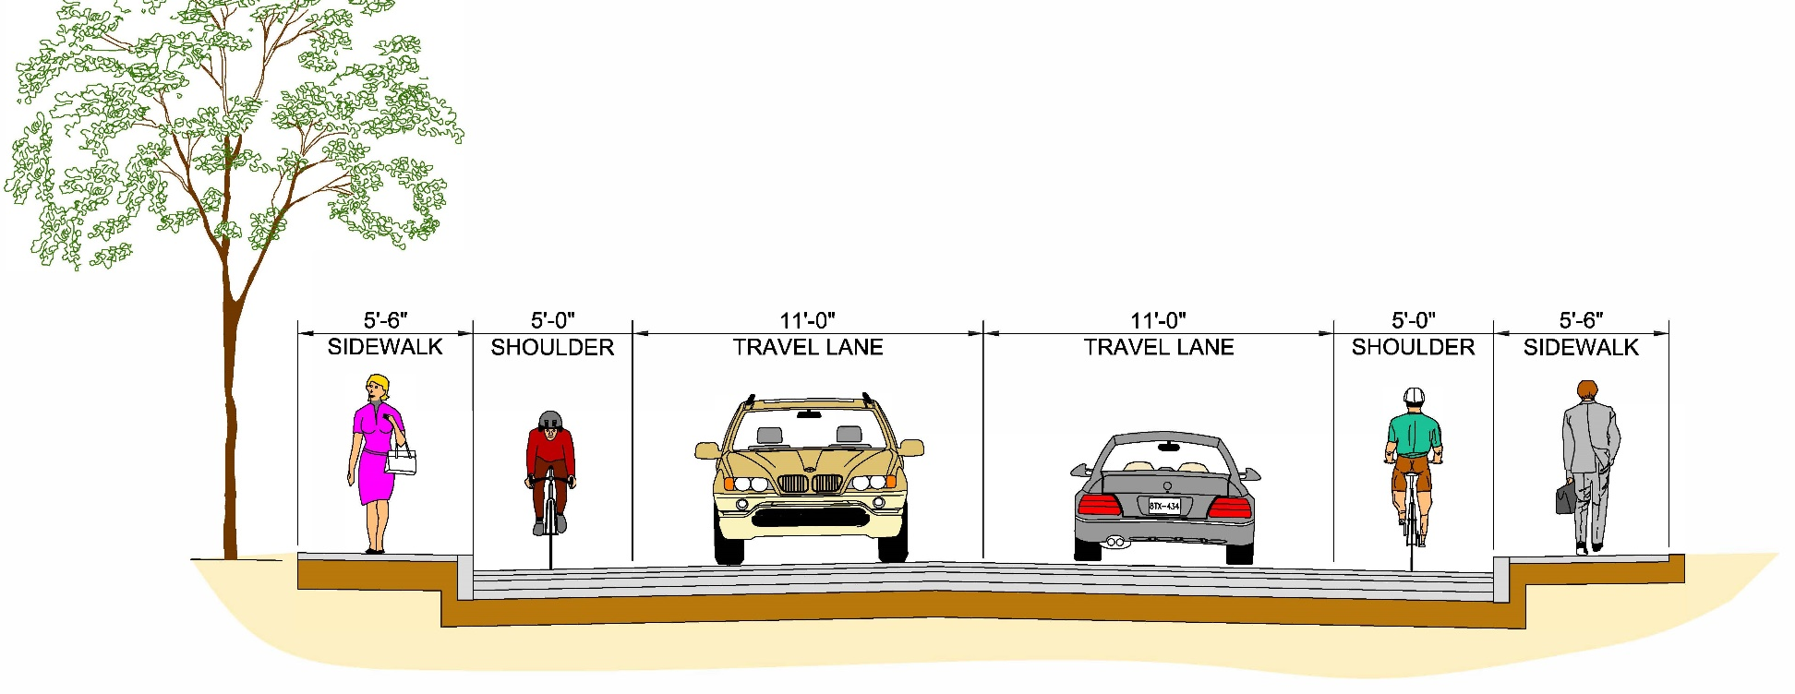
Proposed Improvements
Roadway Pavement Reconstruction
Improve Bicycle Accommodations
Provide 5 ft. wide bike lane while minimizing impacts to parking
Improve Pedestrian Accommodations
Reconstruct Sidewalks & Curb Ramps for ADA compliancy
Reduce crosswalk crossing distances at intersections
Typical Section
5.5’
Sidewalk
5’
Bike Lane
11’
Travel Lane
11’
Travel Lane
5’
Bike Lane
5.5’
Sidewalk

Slide 9
Proposed Improvements
Public Bus Transit
Relocate bus stops for improved operations and ADA compliancy
Address Areas of Congestion
Reconstruct Traffic Signals & Geometric Improvements
Magee’s Corner (Revere Street at Winthrop Street and Main Street)
Revere Street at Crest Avenue/ Highland Avenue
Widen Revere Street north of Kennedy Drive to allow for “pull off” shoulder
Replace Stormwater Drainage System
Deep sump Catch Basins for treatment
New Signage and Pavement Markings

Slide 10
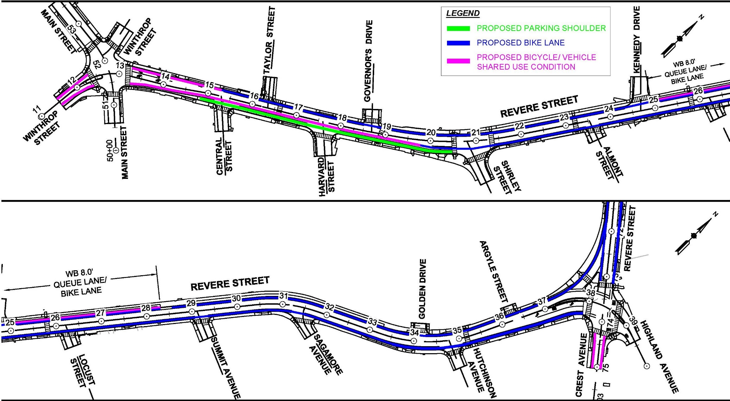
Proposed Improvements (Bike lanes)

Slide 11
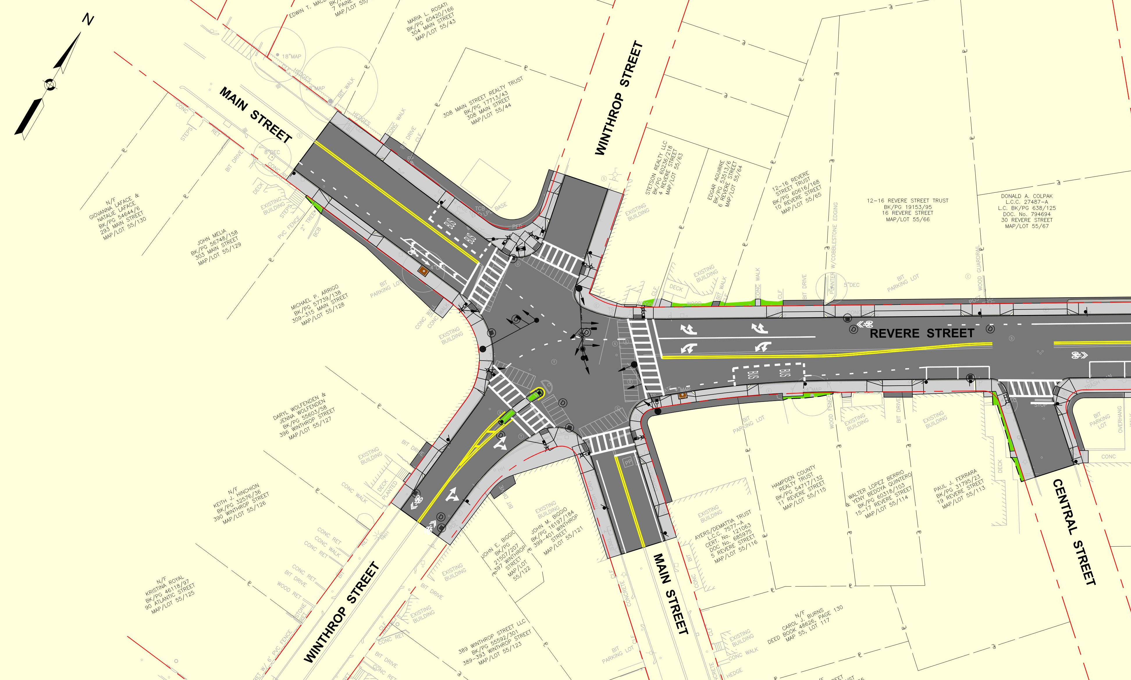
Proposed Improvements
Improvements
Revere St./ Winthrop St. @ Main St. Intersection
Replace traffic signal equipment
Emergency Pre-emption
Bump out sidewalks
NW corner
SE corner

Slide 12
Proposed Improvements
Bus Stops
Relocate Bus stops to far side
New signage
Existing Bus Stop
Future Bus Stop

Slide 13
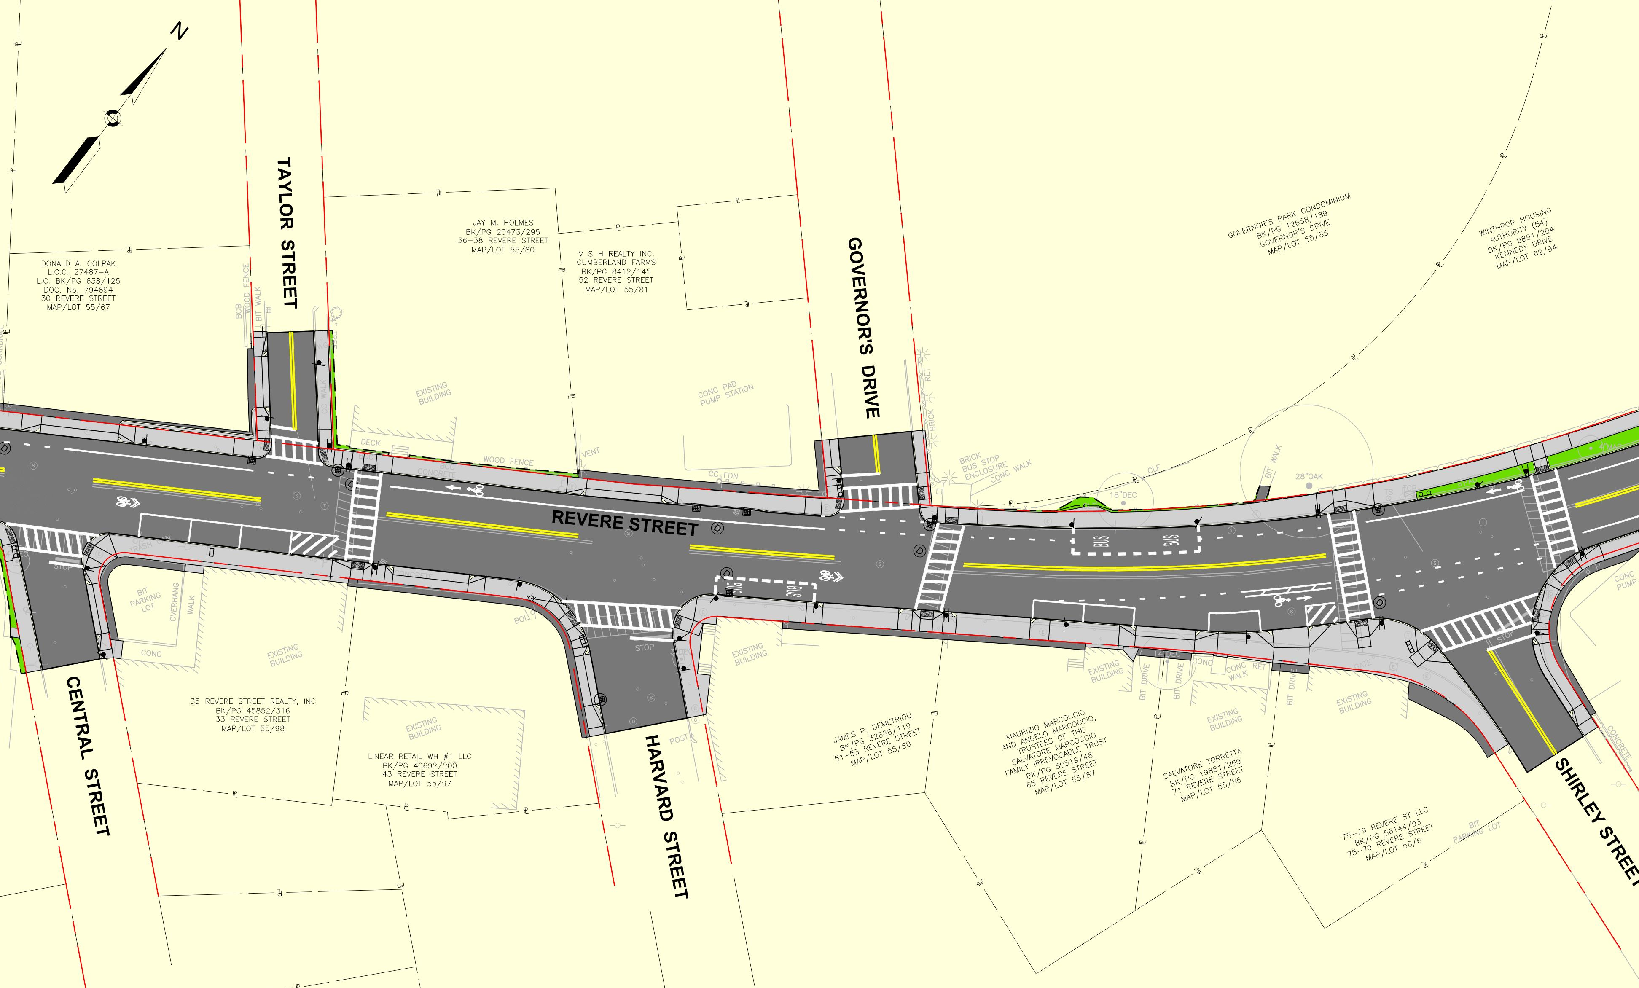
Proposed Improvements
Improvements
Stripe Bike lane on western side
Maintain Parking on eastern side
Revere St. @ Shirley St. Intersection
Add Crosswalk across Shirley St.
Bump out sidewalk
SE corner

Slide 14
Proposed Improvements
Bus Stops
Relocate bus stops away from crosswalks

Slide 15
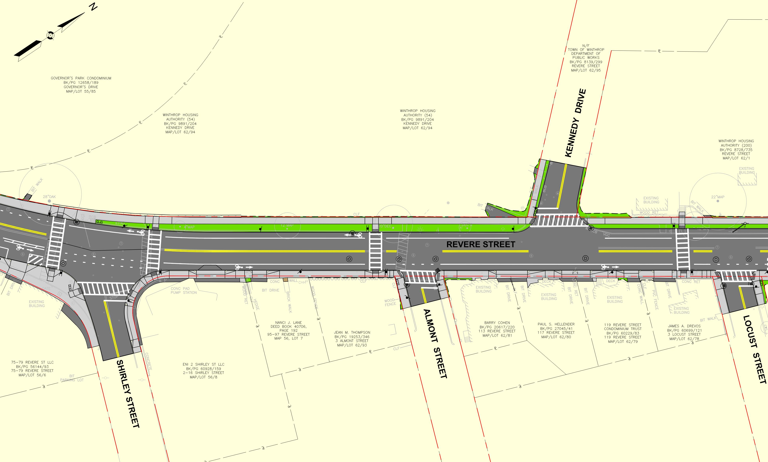
Proposed Improvements
Improvements
Add Crosswalk at Locust St.
Widen western shoulder to 8 ft. between Kennedy Dr. and Summit Ave.
Stripe bike lane both sides

Slide 16
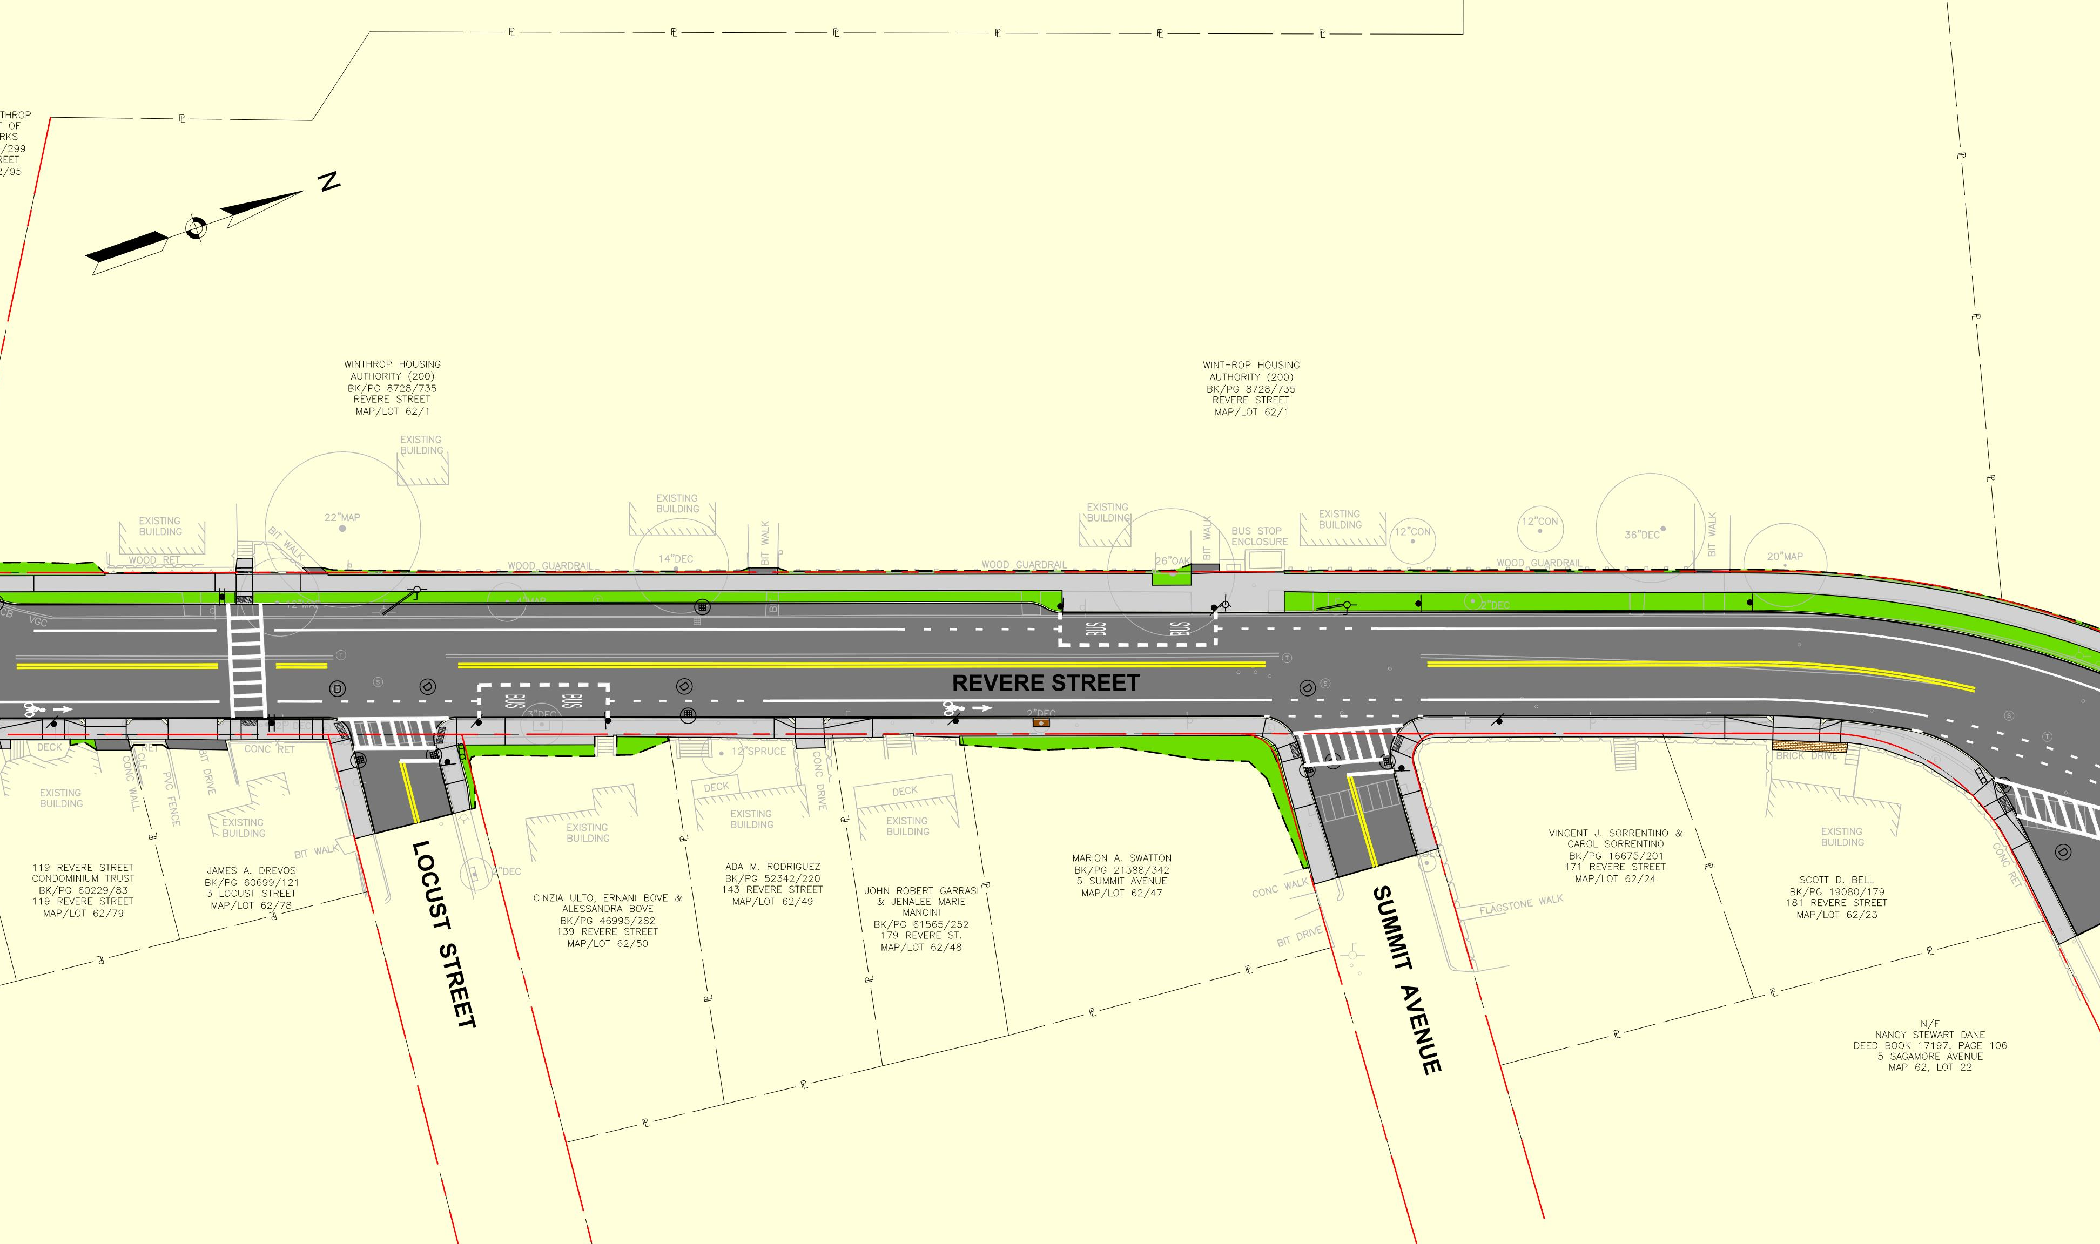
Proposed Improvements
Improvements
Widen western shoulder to 8 ft. between Kennedy Dr. and Summit Ave.
Stripe bike lane both sides

Slide 17
Proposed Improvements
Bus Stops
Relocate NB bus stop from Summit Ave. to Locust St
Relocate SB bus stop away from Summit Ave.

Slide 18
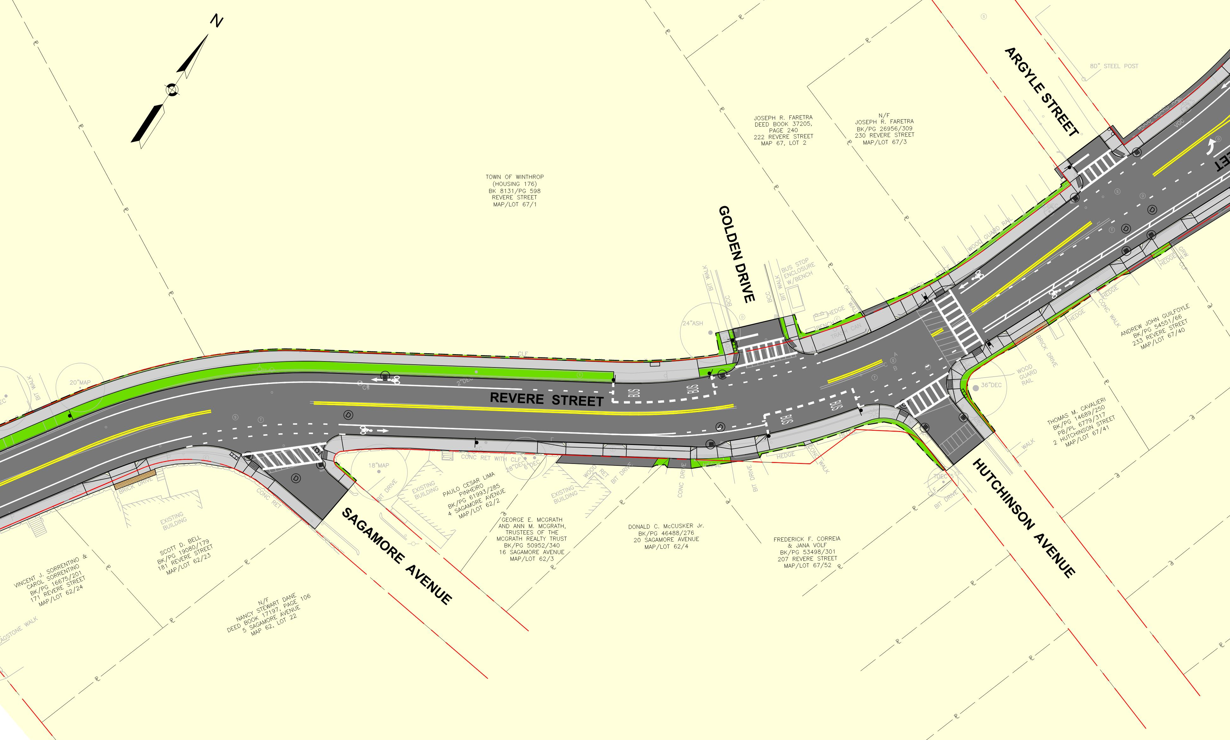
Proposed Improvements
Improvements
Stripe bike lane both sides
Buffered bike lane on east side north of Hutchinson Ave.
Widen sidewalk (2’ +/-) between Hutchinson Ave. and Crest Ave.

Slide 19
Proposed Improvements
Bus Transit Stops
Relocate SB bus stop to far side of Golden Dr.
Maintain NB bus stop on near side of Hutchinson Ave.
Widen sidewalk at bus stop.

Slide 20
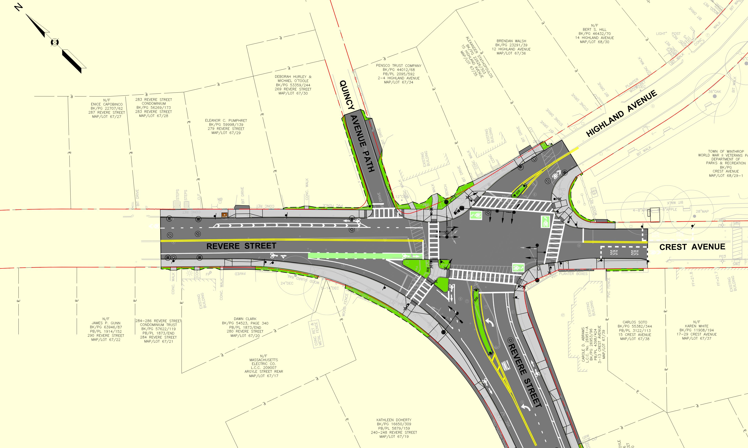
Proposed Improvements
Improvements
Replace traffic signal equipment
Widen Revere St. NB approach
Reconstruct islands
Two-stage-turn-queue-boxes for bicycle left turns
Bump out sidewalks
NW corner, NE corner, SW corner
Reconstruct Quincy Avenue Path pavement

Slide 21
Proposed Improvements
Bus Stops
Relocate NB bus stop to far side along Crest Ave.
Relocate SB bus stop away from intersection.

Slide 22
Next Steps
100% Design – October 2022
Right-of-Way Acquisition – September 2022 to May 2023
Advertise Project for Bids – June 2023
Construction begins - Spring 2024
Construction complete - November 2025

Slide 23

Questions/ Comments
Questions/ comments may also be sent to:
Steven R. Calla
Director of Public Works
(617) 846-1341
scalla@town.Winthrop.ma.us

