Slide 1
Old Middle School Site Presentation

Slide 2
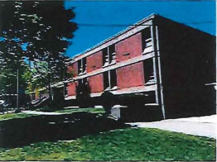
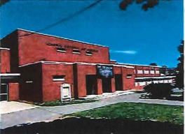
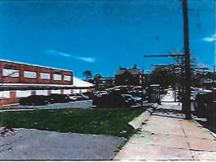
Old Middle School Site

Slide 3
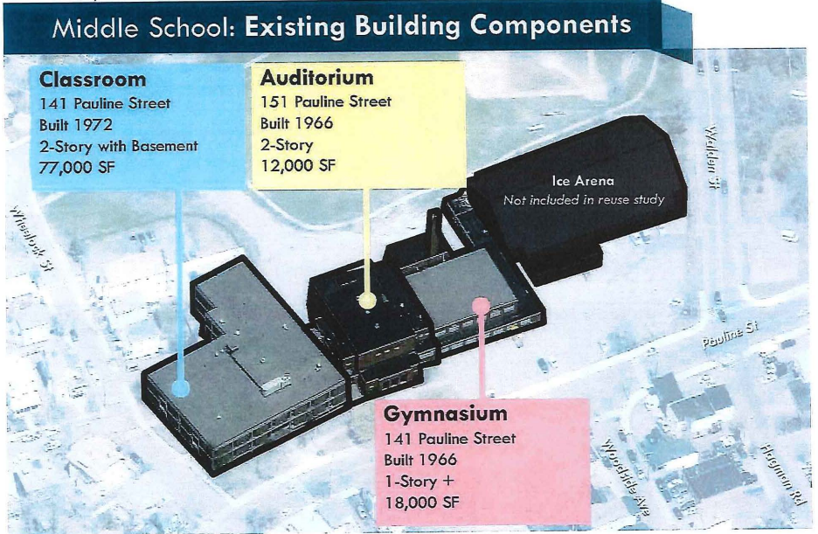

Slide 4
GOALS For This Site
REVENUE STREAM FOR TOWN
STIMULUS FOR BUSINESS
NET INCOME
LESS STRESS ON TOWN DEPARTMENTS
LONGEVITY

Slide 5
PAST PROJECT IDEAS: SITE MISFITS
HOUSING UNITS/ APARTMENT/CONDOMINIUM 100-150 UNITS
COMMUNITY COLLEGE/LOCAL UNIVERSITY ANNEX
PUBLIC SAFETY BUILDING
INCUBATOR COMMERCIAL BUSINESS SPACE
HOTEL
GREEN SPACE
TECH COMPANY

Slide 6
Challenges Our Community Faces
Limited Revenue
Increasing School Population
Density
Limited Development Opportunities
Traffic Congestion

Slide 7
What does Winthrop need on the Middle School site?
A visionary project aimed at igniting economic growth within our town and invigorating local business, while maintaining our charm and uniqueness.

Slide 8
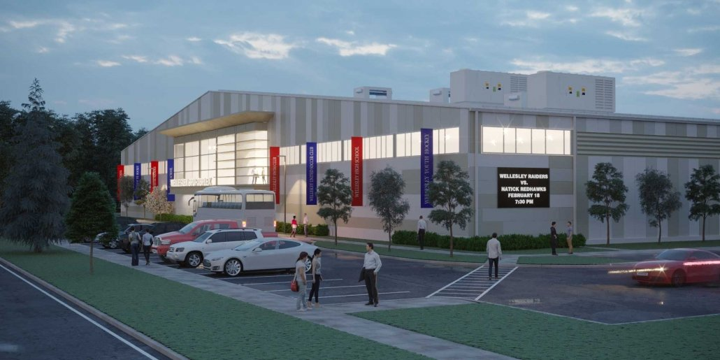
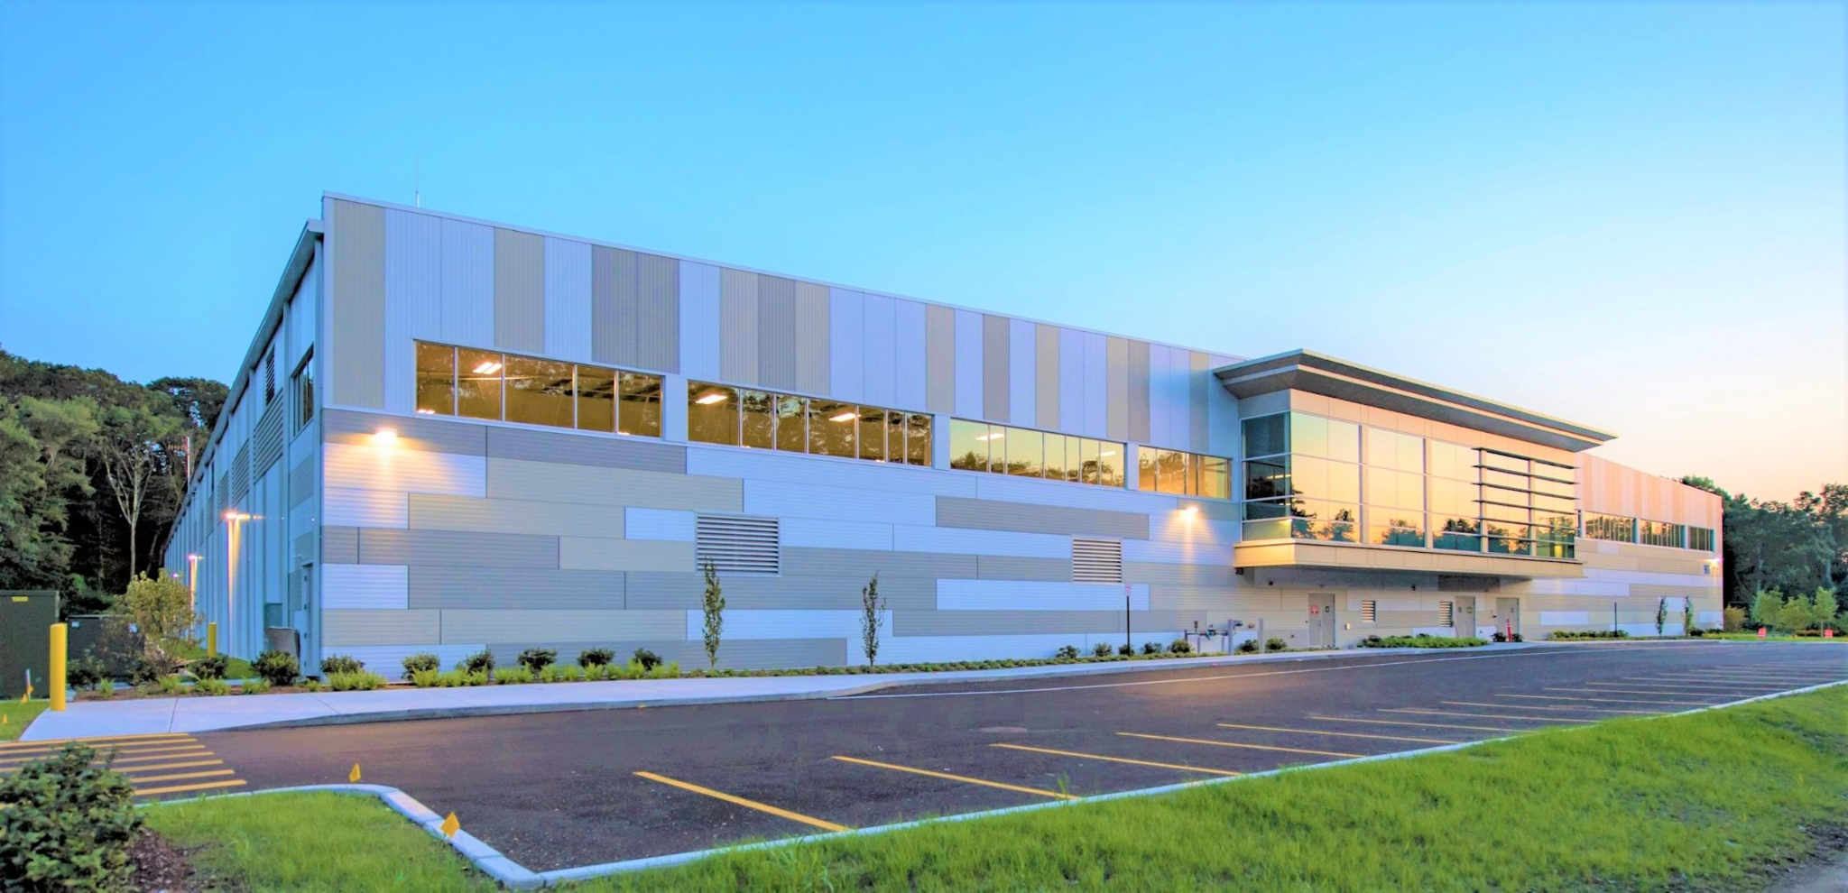
How will we achieve this?
Bbb
By Building A Recreation Center to Spark Economic Growth

Slide 9
The Vision
Find a company that works in conjunction or basically a public/private partnership with communities,
to create a sustainable
year-round athletic ecosystem to benefit users of all
demographics. A company that has an expertise in assessment, design /development, programming, and an operation which allows for the incorporation of an entire community’s recreational and economic
desires, which will serve our community for generations to come. This partnership will enable Winthrop to maintain ownership of the land while our partner would build out the facility.

Slide 10

And . . .
By completing the neighborhood at the top of Waldemar Ave with 3-4 homes created a natural border to the proposed development.
And by creating a greenway behind the homes from Ingleside Park directly to Pauline Street.

Slide 11
THE PLAN
Demolish the existing Middle School, Auditorium & Gym
Partner with a company who will build a facility which would include a multi-functional field house and second sheet of ice.
Secure flexibility to our High School & youth hockey programs, along with figure skating, men’s/women’s leagues and public skating
Secure space for Winthrop’s Parks & Rec Program
Secure time for WHS to use Field House for programs.
Secure times for residents to use Field House year round for fitness and recreation
Secure space for WPD to continue and expand their outreach programs along with space for CASA

Slide 12
THE Multi-Functional FIELD HOUSE: Unlocks Tournament Hosting Potential
Possible Configurations:
4 Basketball Courts
4 Tennis Courts
8 Volleyball Courts
18 Pickleball Courts
Indoor Track
Fitness Area
Viking Lounge

Slide 13
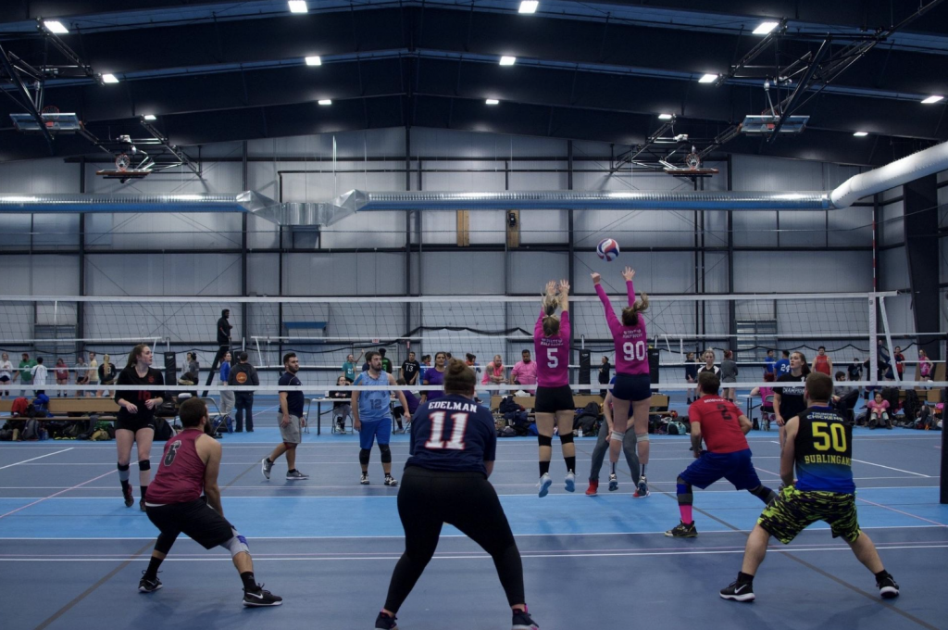

Slide 14
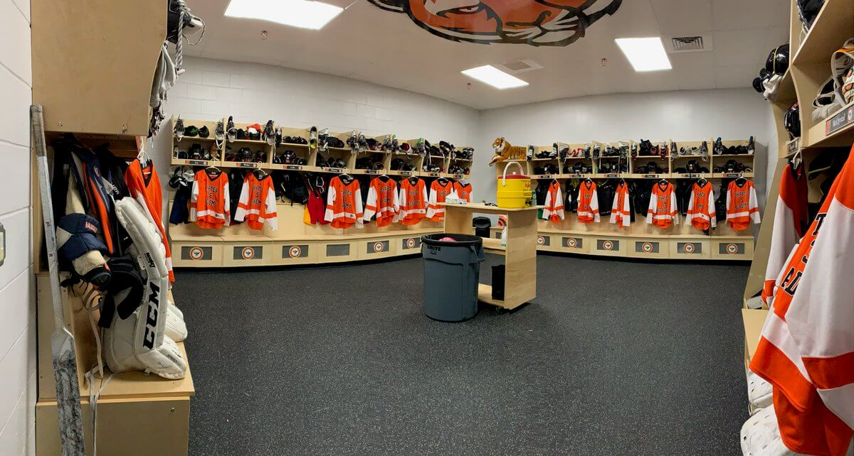

Slide 15
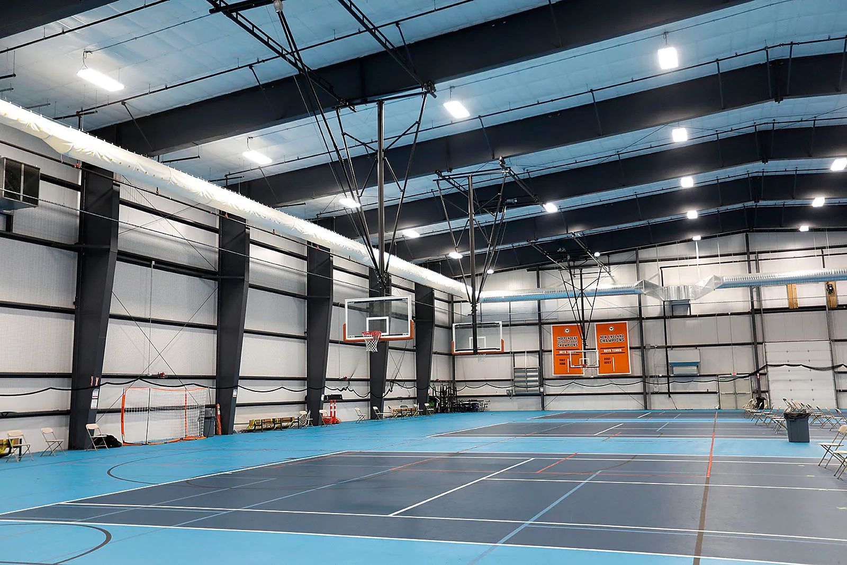

Slide 16
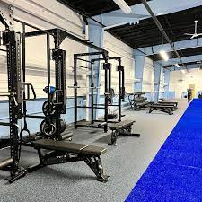

Slide 17
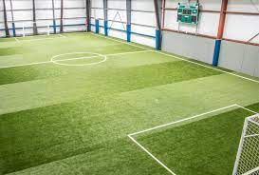

Slide 18
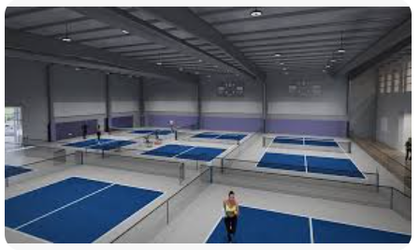

Slide 19
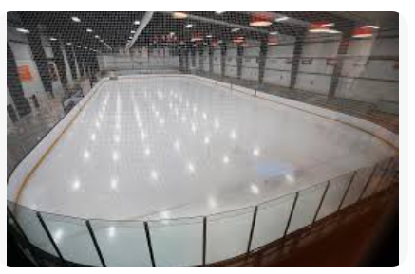

Slide 20
BENEFITS
Revenue stream for our community
Add to the appeal of our community for prospective residents & business
Economic stimulus for business
Magnet for visitors from out of town & state
No burden or cost to our school system

Slide 21
HOW THIS PARTNERSHIP WOULD WORK
Partner would provide the facility and generate revenue through hosting various tournaments throughout the year, whether they be hockey, pickleball, volleyball, tennis, corn hole, ect.
Town would receive benefits as described in previous slide.

Slide 22
ECONOMIC BENEFITS FOR TOWN
Between $30,000-$40,000 in tax revenue from new houses
Between $125,000- $150,000 in rent from Partner
Permanent home for Winthrop Parks & Rec

Slide 23
POTENTIAL NEXT STEPS
Create an RFP
Demolish Site

Slide 24
THANK YOU …….. Much more to come!!!!

