Slide 1

Climate Action Plan for Winthrop
Working Document
Citizens Advisory Commission on Climate (CACC)
February 4, 2025

Slide 2

Contents
CACC Charter, Commissioners & 2025 Meeting Schedule
How Climate Affects Winthrop Residents – Why You Should Care
Goals & Objectives of the Climate Action Plan
Action Plan
Immediate/Short Term (2025-2026)
Medium Term (2027-2028)
Long Term (2029 and Beyond)

Slide 3
CACC Charter / Mission Statement
Recognizing the immediate need for the creation of a comprehensive, informed, actionable, and dynamic climate resiliency and mitigation strategy to “futureproof” our seaside community of Winthrop, the Citizens Advisory Commission on Climate aims to support the Town of Winthrop (“Town”) in accomplishing this task by serving as an advisory board to Town officials through education, awareness, and recommended courses of action with the following goals at the center of its mission:
Baseline current climate-driven challenges for the Town, including frequent flooding, storm surge, sea level rise, etc., and the resulting financial and other implications for the Town and its residents
Synthesize recently documented research studies regarding these challenges, and best practice recommendations on how to address them, including but not limited to:
“ResilientMass Plan” – 2023 Massachusetts State Hazard Mitigation and Climate Adaptation Plan
The climate section of the 2021 "Win2030 Vision" Community Vision for Planning study
The 2017 "Resilient Winthrop - Designing Coastal Community Infrastructure for Climate Change" study that identified and prioritized critical vulnerable infrastructure issues and recommended mitigation and adaptation measures the town can take.
Plans established and actions taken by other municipalities in the greater Boston and other areas around the country and the world to integrate climate resiliency, mitigation into their bylaws, sustainable zoning and development laws, etc.
Synthesize existing Federal and State grants and other funding opportunities as well as agencies and other consultative bodies to support action on these best practice options, including but not limited to:
Federal Inflation Reduction Act of 2022
MA Coastal Zone Management (CZM) Grants
MA Municipal Vulnerability Preparedness (MVP) Program and Department of Energy & Environmental Affairs
Assist and inform the Town Manager, Town Planner and other such leaders in their efforts to work with federal, state and local agencies to secure current and future grants to support our efforts.

Slide 4
CACC Commissioners & 2025 Meeting Schedule
Commissioners
2025 Meeting Schedule
Norm Hyett, Co-Chair
Ana Tavares Leary, Co-Chair
Celeste Ribeiro Hewitt, Secretary
Kim Dimes, Conservation Commission Chair
John DaRos, Town Councilor Precinct 6
Pat Costigan, Town Councilor Precinct 1
Tony Marino, Town Manager
Tom Derdarian, Town Manager Designee, Tree Warden
Commission email: CACClimate@winthropma.gov
Commission Website: https://www.winthropma.gov/630/Citizens-Advisory-Commission-on-Climate
Monday, January 13th
Tuesday, February 4th
Tuesday, March 11th
Tuesday, April 8th
Tuesday, May 13th
Monday, June 2nd
Monday, July 7th
Monday, August 4th
Tuesday, September 9th
Monday, October 6th
Monday, November 3rd
Monday, December 1st
* Inaugural CACC Meeting: August 12, 2024

Slide 5
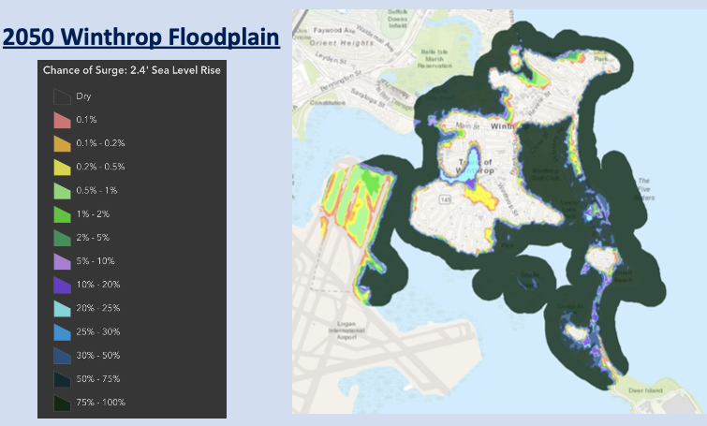
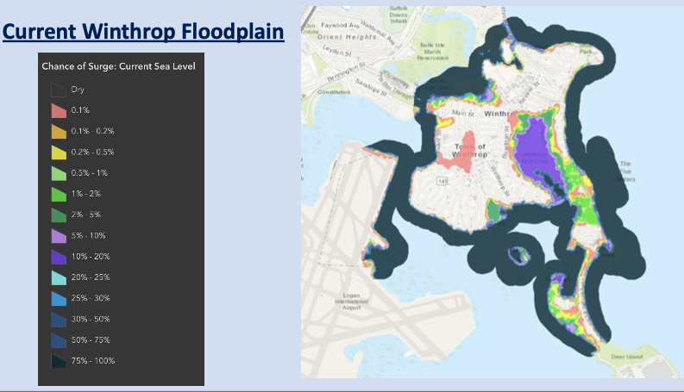
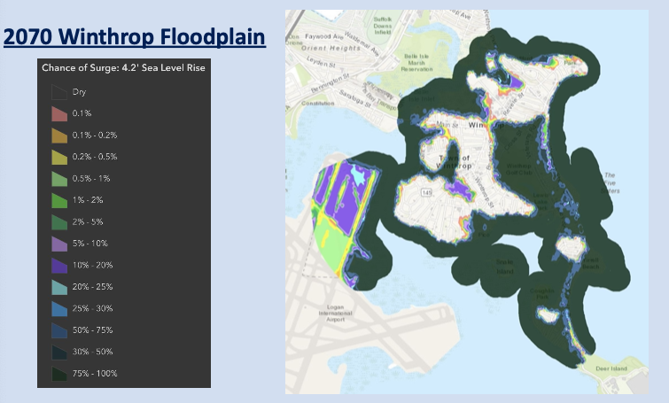
How Climate Change Affects Winthrop Residents
Winthrop’s FEMA Floodplain Map zoning were updated in spring 2024 under the mandate of FEMA and its flood insurance program (non-compliance = town would not qualify for federal flood insurance).
As of that time, 2,902 homes in Winthrop were located on a flood plain.

Slide 6

How Climate Change Affects Winthrop Residents
Flooding & Property Damage / Value Deterioration: Brought on by increasingly intense and frequent storms, precipitation and sea level rise, flooding is damaging homes and property, causing stress, anxiety and financial pain for residents in at least 7 locations across town who worry “when are we getting hit next?” According to the State website Resilient MA, in Winthrop there will be between 1.4 and 2.4 ft. of sea level rise by 2050 and between 4 ft. and 7.6 ft. of sea level rise by 2100. Per the existing 2014 Winthrop Hazard Mitigation Plan (HMP) (update coming in June 2025) between 2006 and 2014, 16 coastal flood events occurred, resulting in $3.11M in property damage; 40 heavy snowfall events occurred 1996-2014, resulting in $9.6M in property damage. Flood Insurance Rate Map (FIRM) issued by FEMA in 2016 which identify properties required to obtain flood insurance show 45% of Winthrop within the "1% annual chance flood" zone (aka "The 100 Year Storm”). Existing High Tide in Winthrop is 9-10 feet. Per Woods Hole Consulting and the ClimateCentral.org flood prediction maps, the chance of an annual flood reaching 7 feet above the high tide line will increase ~50% in the next ~50-70 years. "King Tides" - the highest annual predicted tide of the year along Winthrop's shore and harbor lines - are currently 1-2 feet higher than existing high tide. High Tide is expected to rise 6+ inches in next 15 years; 3+ feet in next 50 years (catastrophic).
The US Army Corps of Engineers is currently studying coastal storm risks on Boston Harbor, which will be completed by 2028. The study could eventually bring hundreds of billions of federal dollars to transform the city’s coastline with permanent flood protections, according to Chris Osgood, Boston City Climate Resilience and Infrastructure Director. Army Corps projects could take decades to build. In the meantime, Boston and Greater Boston coastal municipalities are racing to beef up flood preparations. Boston will spend $250,000 on short-term flood protections in 2025.

Slide 7

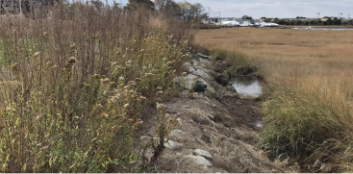



How Climate Change Affects Winthrop Residents
Flood Insurance: Property owners are required to purchase flood insurance if their property falls within the SFHA FEMA floodplain. The Town of Winthrop participates in FEMA’s National Flood Insurance Program (NFIP) with 1,055 policies in force as of July 2, 2020, allowing property owners, renters, and businesses to purchase flood insurance and receive assistance following flood events. Maximum NFIP available coverage limits: $500,000 Direct Physical Damage + $500,000 Personal Property.
As defined by FEMA, a repetitive loss property is any property for which the NFIP has paid two or more flood claims of $1,000 or more in any given 10-year period since 1978. There are 380 repetitive loss structures in Winthrop, the majority of which are single-family homes, although flooding in Winthrop has impacted many multi-family and several commercial structures. These repetitive loss properties had a total of 562 losses between 1978 and 2020, totaling over $4 million in damages.
Due to its coastal location and flood plain footprint, Winthrop’s average flood insurance policy annual premium is well above the $1,045 MA state average and climbing. Without climate resiliency and mitigation, Winthrop is in danger of being on a path to “uninsurability” as is seen in other parts of the country like Florida.
Fixes: Dozens of flood protection projects (berms, sea walls, stormwater drainage systems, etc.) are needed by 2030 to protect low-lying areas from flooding during severe storms.
“Sea level rise and storm surge due to climate change is the defining issue of our time.” - Coletta Zapata, Boston City Councilor
“Making Boston ‘climate ready’ will cost billions.”
- Julia Carlton McKay, Director of Community Resilience, Conservation Law Foundation
“We don’t want to take reserve funds and drain them down to do large projects it is a drop in the bucket and won’t cover it and also impacts our bonding.” - Tony Marino, Winthrop Town Manager

Slide 8
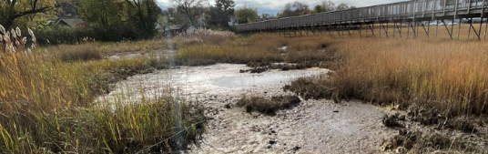
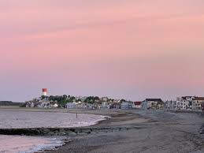
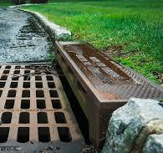
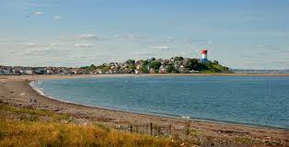

How Climate Change Affects Winthrop Residents
Stormwater Drainage & Sewer Pumps
Among the 16 critical public infrastructure locations in Winthrop now experiencing coastal flooding, sewer pump stations at Pico Beach, Revere Street and Pleasant Court, as well as Pressure Reducing Valve Stations at Bayview Ave, Revere Street, and Underhill Street are all in need of immediate repair.
Salt Marsh Deterioration
As Boston Harbor sea level rises and storm surge intensifies along Short Beach, Belle Isle Marsh’s existence is threatened.
The Marsh serves as a natural storm water “sponge” and filtration, a key tool for climate resiliency. We need to ensure that the Marsh is enhanced and sustainably expanded without turning into a bay, threatening its wildlife habitat along the way.
Beach Erosion
Several steps taken in recent years to provide resiliency at Winthrop Beach have been successful, including the sea wall and jetty construction, as well as protective stone wall distribution on a portion of the beach, preserving the sandy beach and preventing flooding of the beach streets.
At Yirrell Beach, however, erosion in occurring in part due to the massive sea wall constructed alongside MWRA, redirecting tides and currents with an erosive effect.
Evacuation Routes
Flooding occurs on critical path evacuation routes, including Main Street, Shirley Street, Washington Street and Pleasant Street, creating a public safety issue.

Slide 9
Climate Action Plan Goals & Objectives
Short-Term 2025-2026
Medium-Term 2027-2028
Long-Term 2029-2030
Identify Problem Area “Hot Spots” around Winthrop currently experiencing consistent climate-driven impacts such as flooding, storm surge, beach erosion, sea wall deterioration. Focus Areas: Morton/Banks, Pico/Fisherman’s Bend, Tileston/Girdlestone.
Research and Describe Resiliency Solution Options for each hot spot, including required investment estimates and timeframes, asking Town Council / Town Manager to hire consultants as needed.
Update & Publicize Hazard Mitigation / Emergency Management Plan for FEMA Approval (expected completion June 2025)
Identify Potential Funding Sources working with federal, state and regional partners; apply for grants, starting with MVP this spring
Integrate Plan into Town 5-Year Capital Plan starting FY’26
Expand Resiliency Focus to Other ”Hot Spots” including: Short Beach/Revere Street, Yirrell Beach/Point Shirley, CBD/Ingleside Park, Shirley Street/Delby’s Corner, Lewis Lake/Golf Course, Lower Nahant Avenue.
Coordinate Efforts with Existing Agencies and Climate Action Groups, including Friends of Belle Isle Marsh, North Suffolk Office of Resiliency & Sustainability (NSORS), Nature Conservancy, Coastal Zone Management (CZM), City of Boston/Brian Swett, MA Climate Office/Nick Black, City of Revere, Town of Hull/Ian McDonald, DCR/Brian Arrigo, MWRA, MassPort, Katherine Clark (liaison Wade Black), Ed Markey (liaisons Jim Cantwell & Liam Horseman).
Incorporate Decarbonization Initiatives to tackle the root of the problem, working with local, regional, state and federal organizations including Mothers Out Front
Address Any Remaining Urgent Hot Spot Issues to ensure those most affected are experiencing minimal impact.
Assess and Measure Success/Challenges in securing funding, implementing solutions, adjust as needed.
Ensure Climate Action Becomes a Fully-Integrated Part of Town Planning, Budgeting and Success Metrics for Town Council, Town Manager and Relevant Town Departments NOTE: Boston and other cities put climate change and sustainability into their zoning / development bylaws and use a plug-and-play template to apply for grants. Kim Dimes is familiar.

Slide 10
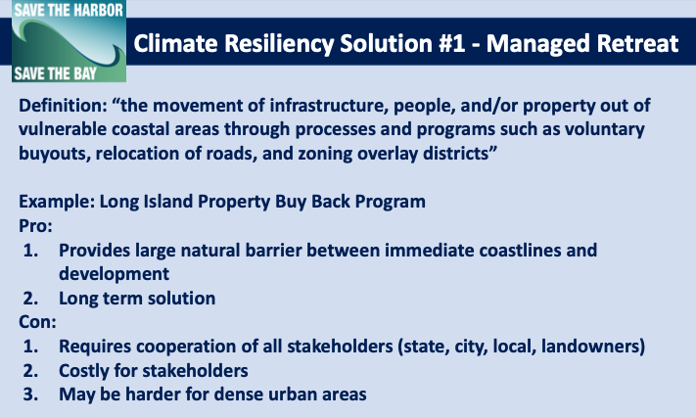
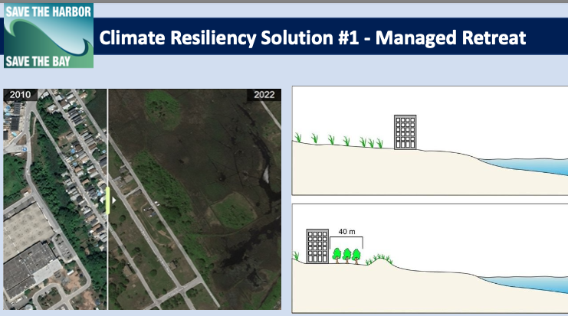
Coastal Resiliency Solution Options that Work

Slide 11
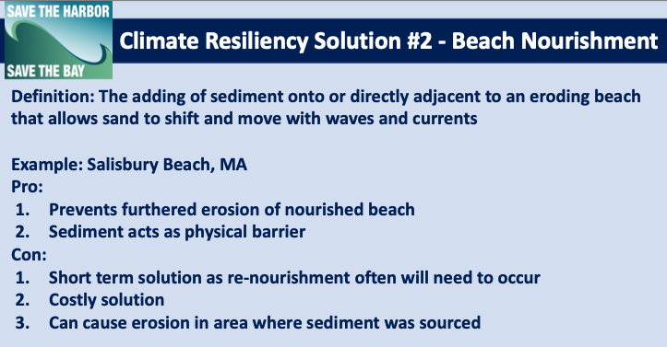
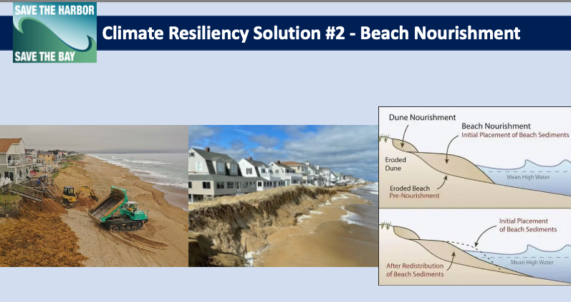
Coastal Resiliency Solution Options that Work

Slide 12
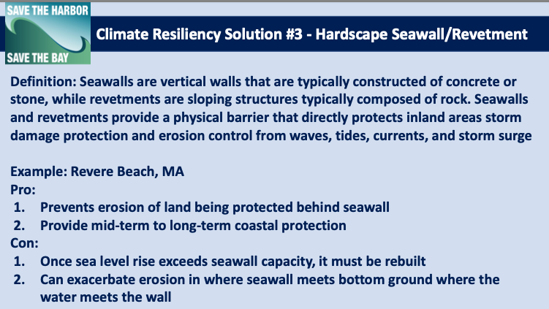
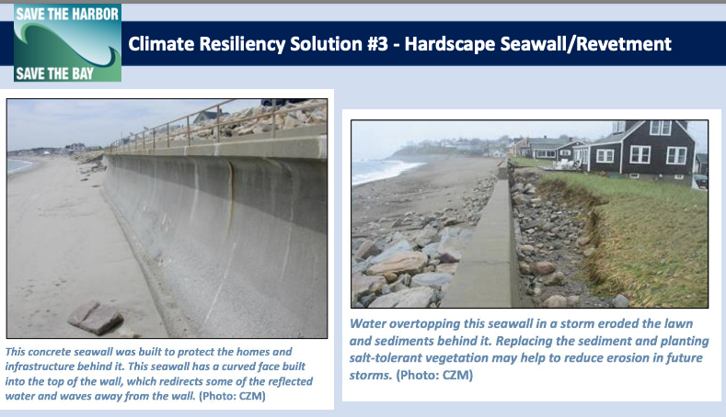
Coastal Resiliency Solution Options that Work

Slide 13
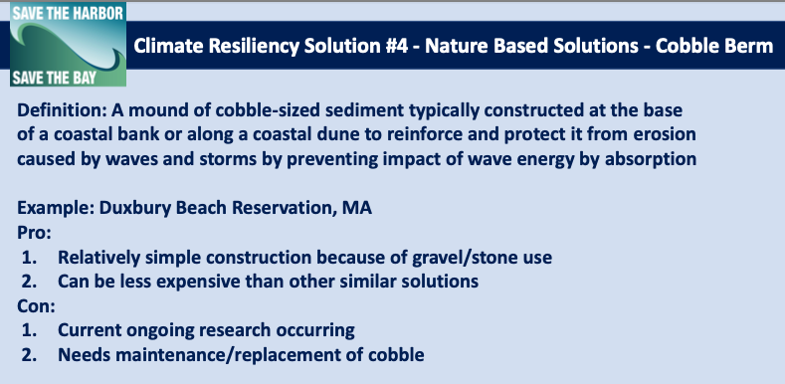
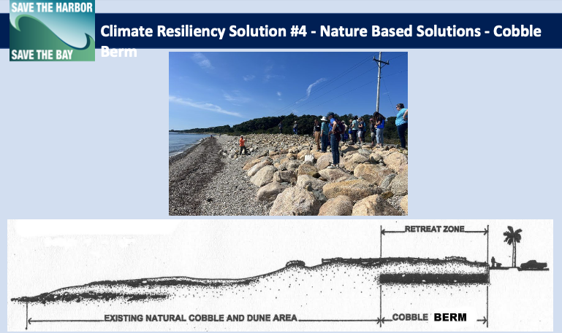
Coastal Resiliency Solution Options that Work

Slide 14
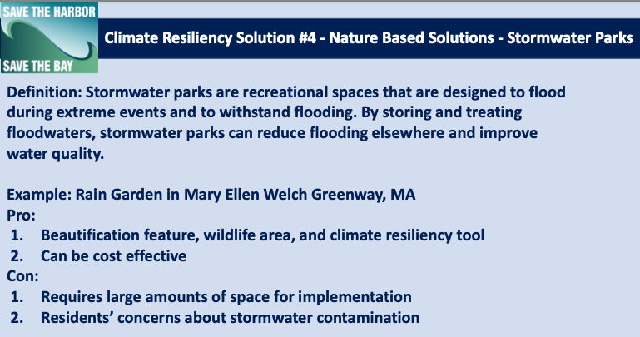
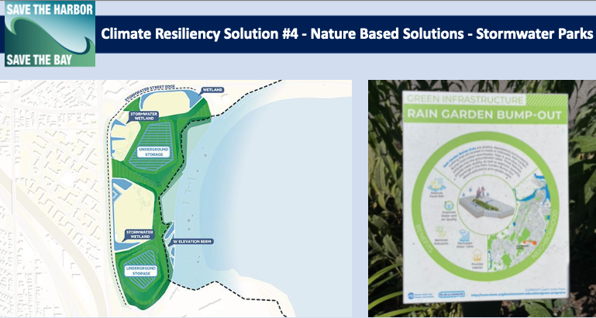
Coastal Resiliency Solution Options that Work

Slide 15
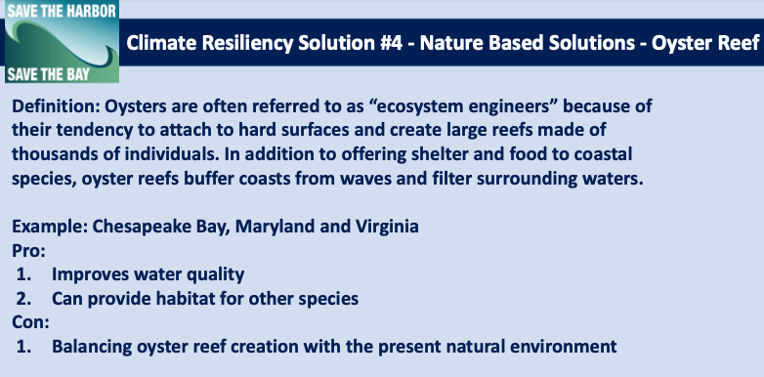
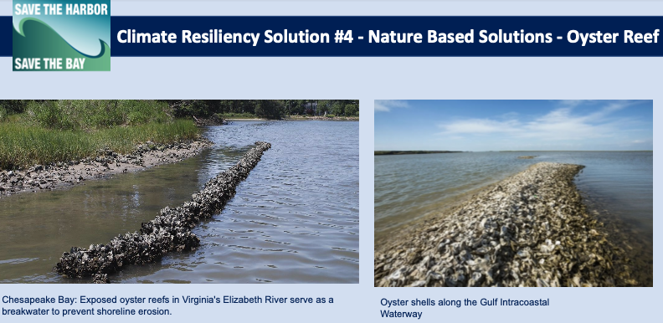
Coastal Resiliency Solution Options that Work

Slide 16
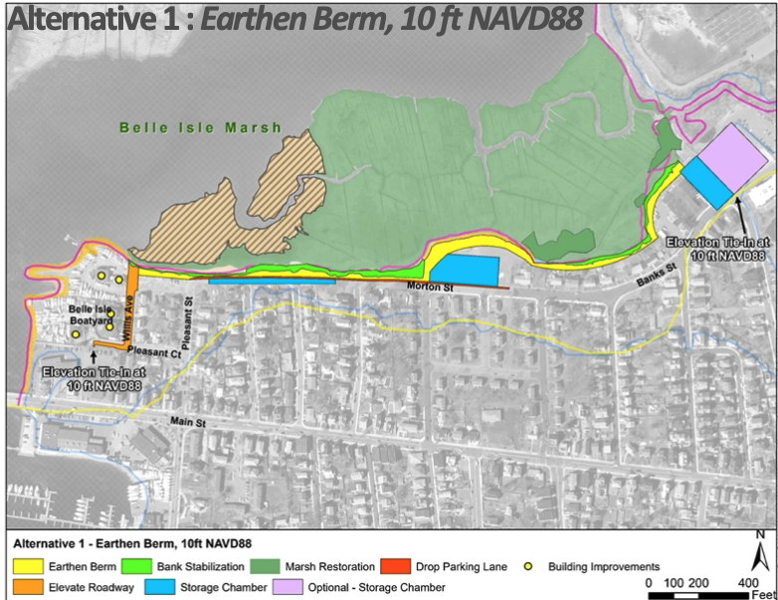
Hot Spot #1 – Morton & Banks Streets
Project
Phase
Investigation / Solution Vetting (~60 Days)
Initial (30%) Solution Design & Cost Estimate (~120 Days)
Funding Grant / Debt Exclusion (~60-90 Days)
Final Design, Engineering & Permitting (~180 Days)
Construction (~2 Years)
SITUATION
Marsh shoreside and nearby residential and commercial property flood multiple times per year due to both storm surge and rainfall
Increasing risk through 2070 with potential of Marsh transforming into a bay, destroying a key storm surge absorption buffer and wildlife habitat
Approximately 70 homes impacted/at risk - most/all could be saved by the proposed mitigation(s)
DESIRED OUTCOMES
Reduce risk to sea level rise, storm hazards and rainfall flooding
Minimize erosion
Enhance and expand existing wetlands resources
Increase water quality, stormwater capture and infiltration
Manage Flood Insurance Costs (Note: Per Heather O’Brien, Friends of Belle Isle Marsh Community Advisory Manager, having our berm become a “Certified Levy System” by the Army Corps of Engineers removes flood insurance requirement (?))

Slide 17
Hot Spot #1 – Morton & Banks Streets
Project
Phase
Investigation / Solution Vetting (~60 Days)
Initial (30%) Solution Design & Cost Estimate (~120 Days)
Funding Grant / Debt Exclusion (~60-90 Days)
Final Design, Engineering & Permitting (~180 Days)
Construction (~2 Years)
SOLUTIONS
IN-FLIGHT
Morton St residents want three (3) things from the Town:
Close the road before it floods
Provide sandbags
Install "duckbills" on the storm drains
Banks St residents generally support a berm in their backyard
- Impacts of raising Banks St are not feasible
- Outfalls in need of check valves/flap gates
- Residents are interested in temporary mitigation measures
- Many residents considering moving, open to buyouts
Recent resident suggestions:
Ask Massport to reinforce the rock walls along the Marsh shoreline.
Research and perhaps duplicate recent “living seawall” installed in front of new waterfront residences in East Boston (see November 2024 article in Boston Globe).
Installed sandbags in mid-January around the foundation perimeter of the ten most impacted homes along the marsh.
Long term fixes:
Add backflow prevention to the existing pipes to stop the high tides from coming up through the catch basins (pipe is currently buried in the ground)
Enlarge existing pipes and storage capacity
Earthen Berm & Bank Stabilization (recommended by Wood’s Hole): Install an earth berm along the walkway. Will require easements or takings of existing homes backyards to complete. Berm will be a 2-3 foot earthen mound located inland of wetland resources. Impermeable core required to protect against seepage and erosion.
17

Slide 18
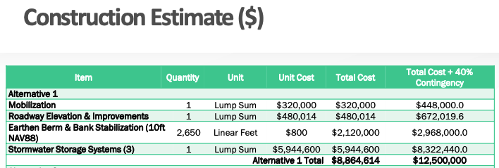
Hot Spot #1 – Morton & Banks Streets
Project
Phase
Investigation / Solution Vetting (~60 Days)
Initial (30%) Solution Design & Cost Estimate (~120 Days)
Funding Grant / Debt Exclusion (~60-90 Days)
Final Design, Engineering & Permitting (~180 Days)
Construction (~2 Years)
*NOTE: Woods Hole original estimate on the left, edited down to the three steps on the previous page – adjusts estimated investment required down to around $5M.
REQUIRED PERMITTING
FUNDING
STATUS
$1.047M in MVP grants received over the past decade for climate action planning, including grant awarded last spring used to hire Conor/Woods Hole for Morton/Banks
$1.2M MVP grant for engineering and permitting denied on 10/16/24. Re-applied for FY26, still waiting for an answer
Researching other options, including National Fish & Wildlife Foundation (NFWF) and FEMA Building Resilient Infrastructure & Communities Fund (need to be shovel-ready).
MEPA Expanded ENF & Single EIR
ConCom Notice of Intent

Slide 19
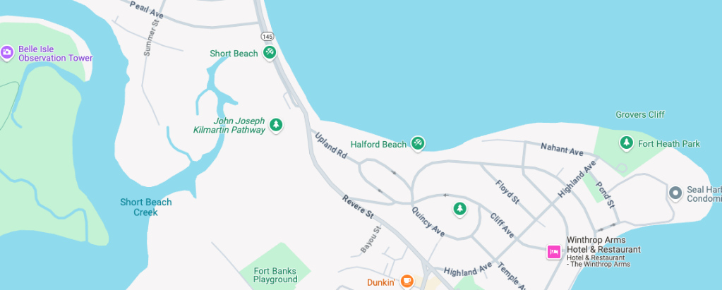
Hot Spot #2 – Short Beach / Revere Street
Project
Phase
Investigation / Solution Vetting (~60 Days)
Initial (30%) Solution Design & Cost Estimate (~120 Days)
Funding Grant / Debt Exclusion (~60-90 Days)
Final Design, Engineering & Permitting (~180 Days)
Construction (~2 Years)
SITUATION
Frequent storm surge causing egress closure & damage to existing sea wall and Revere Street roadway
Dated vulnerability assessment needs updating to ensure plan sufficiently supports both resident evacuation out of town, and delivery of aid and first responders into the town.
DESIRED OUTCOMES
Ensure roadway is operable during moderate storms; gate is only closed when absolutely necessary during the most severe storms (depending upon solution, eventually gate may not be necessary at all).
Ensure water re-direct from the sea wall doesn’t negatively impact Lower Nahant Avenue.
Take advantage of the “sponge” of Belle Isle Marsh to absorb the stormwater, while ensuring Marsh doesn’t flood – need to research options for water egress on other sides of the Marsh.
19

Slide 20
Hot Spot #2 – Short Beach / Revere Street
Project
Phase
Investigation / Solution Vetting (~60 Days)
Initial (30%) Solution Design & Cost Estimate (~120 Days)
Funding Grant / Debt Exclusion (~60-90 Days)
Final Design, Engineering & Permitting (~180 Days)
Construction (~2 Years)
SOLUTIONS
IN-FLIGHT
The Woods Hole Group with Conor as the lead is currently looking at long term options to stop the flooding and allow for access to and from Winthrop during flooding events.
Two Options Under Consideration (DCR):
1. Repair and raise Short Beach seawall (most likely solution), or
2. Replace roadway with a new bridge (more costly and less likely to be considered)
Also looking at nature-based solutions as alternatives or supplements, including a Five Sisters-style breakers.
Berm on the ramp to the bridge at Winthrop Pkwy also need to be replaced.
Current Conceptual Phase: In consultation with DCR whose priority is protecting the evacuation route. Stantec is the consultant, and the feasibility report will be released in June 2025. WoodsHole Group did the modelling for this project.
Need environmental impact analysis to consider implications for Belle Isle Marsh and its neighboring communities East Boston/Bennington and Revere
REQUIRED PERMITTING
TBD
FUNDING
STATUS
TBD

Slide 21
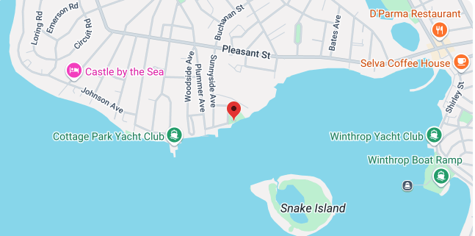
Hot Spot #3 – Pico Beach / Fisherman’s Bend
Project
Phase
Investigation / Solution Vetting (~60 Days)
Initial (30%) Solution Design & Cost Estimate (~120 Days)
Funding Grant / Debt Exclusion (~60-90 Days)
Final Design, Engineering & Permitting (~180 Days)
Construction (~2 Years)
SITUATION
Current 8” pipes not adequate, cracked and broken, brick structures failing
Outflow of stormwater was buried in the sand, causing backup.
Problem persists because the capacity of the system itself is insufficient, inefficient, and leaking
Engineering work for the stormwater fix to include the seawall extension is needed for this neighborhood. Stormwater storage is key. Permitting cost estimate pending.
DESIRED OUTCOMES
Minimize flooding and erosion
Manage mosquito problem experience by nearby residents
Addressing backed up drainage / pump systems could solve both

Slide 22
Hot Spot #3 – Pico Beach / Fisherman’s Bend
Project
Phase
Investigation / Solution Vetting (~60 Days)
Initial (30%) Solution Design & Cost Estimate (~120 Days)
Funding Grant / Debt Exclusion (~60-90 Days)
Final Design, Engineering & Permitting (~180 Days)
Construction (~2 Years)
SOLUTION
REQUIRED PERMITTING
TBD
Increase capacity of stormwater pipes, backflow prevention (two options – duckbill valves, flapper valves)
Extend sea wall
Ask NE Mosquito Control to dredge out ditches at FB (Army corps backlog up to 18 months)
Address the flooding from the marsh, similar to Belle Isle
Replace and move current 75-year old water mains to accommodate the new pipes
FUNDING
STATUS
Town Manager is due to provide us with an update for the next $158,500 required to get us to the permitting phase.
Some money in the capital plan
Another round of MVP application (~$400K) to manage the marsh. Original grant application in 2024 was denied.
IN-FLIGHT
Town Council approved $60K last spring to survey all flooding issues for Pico, Tileston & Girdlestone as beginning of phased approach to address issues. Another $80K for phase one of engineering (baseline mapping, preliminary design) was passed.

Slide 23
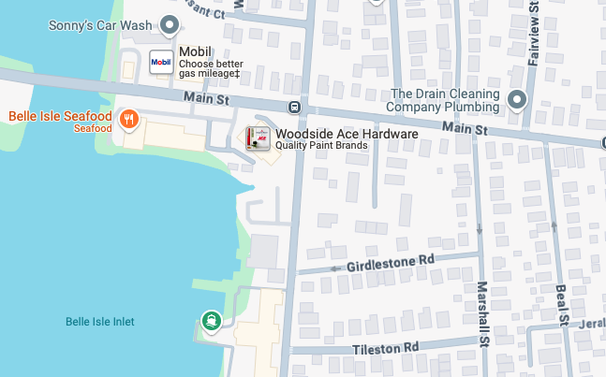
Hot Spot #4 – Tileston & Girdlestone Streets
Project
Phase
Investigation / Solution Vetting (~60 Days)
Initial (30%) Solution Design & Cost Estimate (~120 Days)
Funding Grant / Debt Exclusion (~60-90 Days)
Final Design, Engineering & Permitting (~180 Days)
Construction (~2 Years)
SITUATION
Flooding from stormwater and heavy precipitation on a regular basis
DESIRED OUTCOMES
Minimize flooding, focusing on improving pumps and drainage
SOLUTION
Enhanced pumps and drainage; catch basin repair/replace; backflow prevention
IN-FLIGHT
REQUIRED PERMITTING
Permit from the state required to expand the seawall
Pumps secured and implemented last spring.
1/2 of the engineering work has been completed (~$250K out of the ~$580K total)
Motion from Town Manager Marino to Town Council to approve funding for remainder of engineering, design and permitting work for Morton, Pico and Tileston/Girdlestone.
FUNDING
STATUS
TBD: either grants or debt exclusion to fund construction

Slide 24
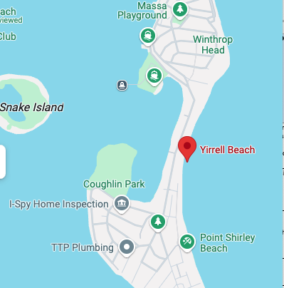
Hot Spot #5 – Yirrell Beach
Project
Phase
Investigation / Solution Vetting (~60 Days)
Initial (30%) Solution Design & Cost Estimate (~120 Days)
Funding Grant / Debt Exclusion (~60-90 Days)
Final Design, Engineering & Permitting (~180 Days)
Construction (~2 Years)
SITUATION
Sand, rocks, cobble have filled in the front of seawall, reducing the seawall to about 2 feet. DPW rakes the beach every year to help this.
A berm was built, then DEP issued a stop work order (Wetlands Compliance Act). Consultant reviewed this for us. Beach has 1 year of no berm maintenance, leaving minimal protection. No homes have flooded yet, but likely will if no action taken.
DEP is classifying Yirrell as a coastal dune vs. a barrier beach, which places limits on what we can do.
Precinct 3 constituents are upset because DEP and others are focused on the wildlife protection and MWRA protection and not homeowner protection.
Planted dune 25' in front of the existing seawall will need to be installed in compliance with the Administrative Consent Order (ACO) that we are working under with DEP. Send sand samples for testing, then dune building will start in the spring of 2025.
Some homeowners’ stairs going down to the beach will have to be removed. Town will install 5 access points.
Eventually, 2-3 feet needs to be added to the Yirrell sea wall and a berm (~2,000 cubic yard?) needs to be built.
SOLUTION
IN-FLIGHT
Currently procuring a sand vendor for the coastal berm
Installation to begin in Fall 2025
REQUIRED PERMITTING
No permits required under an ACO
FUNDING
STATUS
CZM grant received in 2019, used for Coughlin Park shoreline

Slide 25
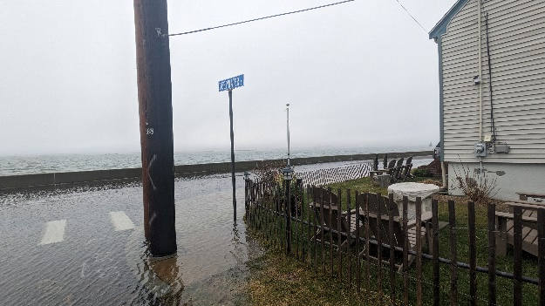
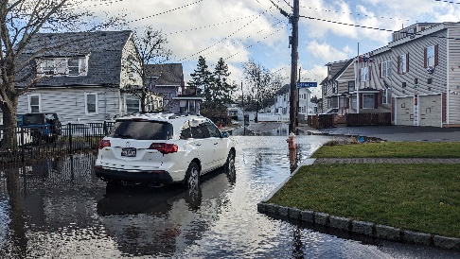
Hot Spot #6 – Point Shirley Harborside
Project
Phase
Investigation / Solution Vetting (~60 Days)
Initial (30%) Solution Design & Cost Estimate (~120 Days)
Funding Grant / Debt Exclusion (~60-90 Days)
Final Design, Engineering & Permitting (~180 Days)
Construction (~2 Years)
SITUATION
Point Shirley residents Belinda Borrelli and her neighbor Katherine attended the CACC’s “Coastal R&R” event in May 2025 at which time they advised of the flooding occurring in their neighborhood on Billows, Grandview and Deepwater streets, providing photos shown here →
Belinda & Katherine report that Bayview is inundated and impassible during recent storms, affecting numerous houses in the neighborhood with water a few feet high around several houses. Grandview is also problematic, impacted by 11-foot high tidal surge that comes within inches of the top of the sea wall with splash over occurring even on sunny days and waves over the wall during storms. They suggest either the wall needs to be higher, or the boulders along the shore need to be extended out.
Raise the Sea Wall?
Extend out the shoreline boulders?
Both?
DESIRED OUTCOMES
Homeowner flood protection
Manage flood insurance costs
SOLUTION
REQUIRED PERMITTING
TBD
FUNDING
STATUS
TBD

Slide 26
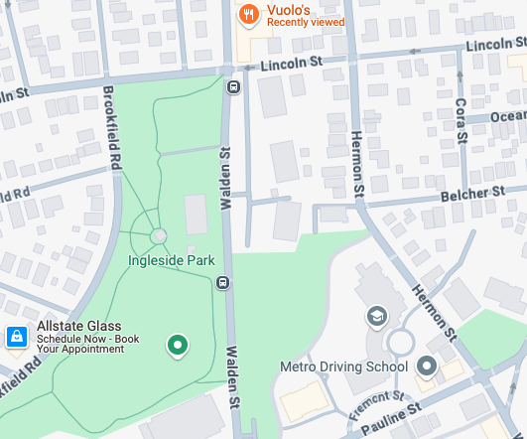
Hot Spot #7 – Central Business District / Ingleside Park
Project
Phase
Investigation / Solution Vetting (~60 Days)
Initial (30%) Solution Design & Cost Estimate (~120 Days)
Funding Grant / Debt Exclusion (~60-90 Days)
Final Design, Engineering & Permitting (~180 Days)
Construction (~2 Years)
SITUATION
Walden Street floods with any significant amount of rain, particularly at intersection with Lincoln (near Vuolo's)
Ingleside Park stormwater outflow drainage still a central issue – narrow pipe under the park chokes off stormwater drainage
Ingleside drainage project in Winthrop Center never finished - $15-20M need
Replace and upsize pipe running under the park.
Replace outfall pipe and chamber / increase capacity at Donovan Beach
SOLUTION
REQUIRED PERMITTING
TBD
DESIRED OUTCOMES
Homeowner and business owner flood protection
FUNDING
STATUS
Approach State Revolving Fund (SRF)

Slide 27
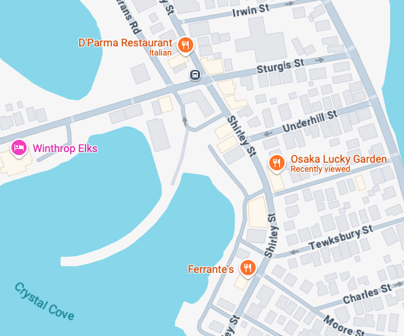
Hot Spot #8 – Shirley Street / Delby’s Corner
Project
Phase
Investigation / Solution Vetting (~60 Days)
Initial (30%) Solution Design & Cost Estimate (~120 Days)
Funding Grant / Debt Exclusion (~60-90 Days)
Final Design, Engineering & Permitting (~180 Days)
Construction (~2 Years)
SITUATION
Shirley Street floods with any significant amount of rain, particularly at intersections with Sturgis and Underhill
Pipe sleeve put in on Pleasant Street so pipes can be connected easier and not shut down the road.
SOLUTION
DESIRED OUTCOMES
Homeowner and business owner flood protection
REQUIRED PERMITTING
TBD
FUNDING
STATUS
TBD

Slide 28
Decarbonization Initiatives – Addressing Root Cause
Project
Phase
Investigation / Solution Vetting (~60 Days)
Initial (30%) Solution Design & Cost Estimate (~120 Days)
Funding Grant / Debt Exclusion (~60-90 Days)
Final Design, Engineering & Permitting (~180 Days)
Construction (~2 Years)
Future of Clean Heat Initiative – Conversion from Natural Gas to Networked Geothermal; Pursuing potential pilot program with National Grid, similar to Framingham and Lowell
Electricity Aggregation – Good Energy Program Adoption
Air Quality & Noise Pollution Reduction – Oppose Private Jet Expansion at Logan; Stay Tuned to MassPort Environmental Quality Study and Related Commitments
Composting – Expansion of Good Earth program; pursue trash fee credits for participants
Green Communities Program – Winthrop has received $2M+ since the passing of the 2008 Green Communities Act. $200K received last year used for rooftop electrification for heating and A/C. Going for another $200K grant in the fall for more fossil fuel reduction.

Slide 29
Asks of the Community
Stay Informed: Commission Website: https://www.winthropma.gov/630/Citizens-Advisory-Commission-on-Climate
Stay Engaged, Offer Suggestions & Perspectives Commission email: CACClimate@winthropma.gov Town Council email: towncouncil@town.winthrop.ma.us Town Manager email: amarino@winthropma.gov
Attend future monthly meetings
Tuesday, March 11th
Tuesday, April 8th
Tuesday, May 13th
Monday, June 2nd
Monday, July 7th
Monday, August 4th
Tuesday, September 9th
Monday, October 6th
Monday, November 3rd
Monday, December 1st

