Slide 1

Parks and Recreation Department
Cost Recovery Plan
City Council Presentation
June 27, 2023
6:30 p.m.

Slide 2





Agenda
Project Background
Summary of Findings
Recommendations & Considerations
Questions and Discussion

Slide 3
1: Project Background

Slide 4



Project Background
The Town partnered with BerryDunn to assist with preparing a cost of service (CoS) analysis and reviewing the master fee schedule for the Parks and Recreation Department.
BerryDunn met on multiple occasions with Town staff and stakeholders, prepared the CoS analysis, and developed fee schedule recommendations designed to satisfy revenue requirements for the Department and maintain a sufficient fund balance.
BerryDunn compiled all staff and stakeholder feedback, financial and operational analysis methodologies, and findings and recommendations into a final project report and CoS model.
BerryDunn presented findings and recommendations to staff, stakeholders, and the City Council for review, consideration and acceptance.

Slide 5
2: Summary of Findings

Slide 6
Summary of Findings – FY 2019
Revenue: $297,977
Expense: $357,894
Cost Recovery: 83.3%
Revenue Shortfall from Full Cost: ($59,917)
Reserve Fund Balance reduction due to revenue shortfall

Slide 7
Summary of Findings – FY 2022
Revenue: $293,056
Expense: $328,006
Cost Recovery: 89.3%
Revenue Shortfall from Full Cost: ($34,950)
Reserve Fund Balance reduction due to revenue shortfall

Slide 8
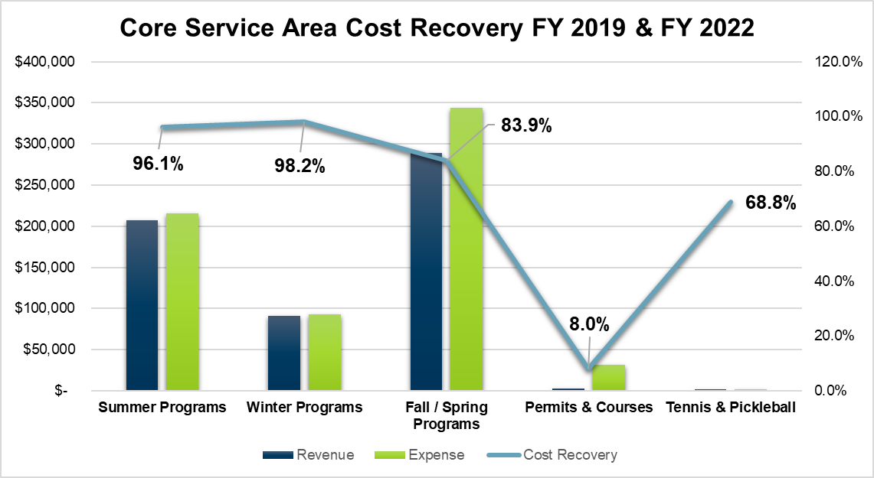
Summary of Findings – FY 2019 and FY 2022
Of the all activities, programs and service categories analyzed, none recovered the full-cost of providing services.

Slide 9
Summary of Findings – FY 2019 and FY 2022
Of the all activities, programs and services analyzed, those related to fall/spring programs and services accounted for 48.8% of total revenue generation.

Slide 10
Summary of Findings – FY 2019 & FY 2022
BerryDunn identified and assigned $591,033 of revenue and $685,900 of estimated expense to all Department activities, programs, and services for FY 2019 and FY 2022.
BerryDunn identified $27,725 of grant funding secured for FY 2019 and FY 2022.
BerryDunn identified $132,977 of indirect and non-discretionary expense for FY 2019 and FY 2022
The Department reserve fund balance declined in FY 2019 and FY 2022.
BerryDunn identified a reserve fund balance of $31,033 at the start of FY 2023 and projects a slight decline at the end of FY 2023

Slide 11
3: Recommendations & Considerations

Slide 12
Recommendations and Considerations
Fee Adjustments: The Department should consider fee adjustments as recommended in FY 2024. Adjustments of 5% to 7% of select, specific fees should be considered:
Summer and Winter Programs, estimated 5% increase
Fall and Spring Programs, estimated 7% increase
Cost Recovery: The Department should continue monitoring targeted ranges of cost recovery annually related to specific permit and service categories, and consider adjusting fees accordingly, when cost recovery levels begin to significantly impact the reserve fund balance.
Activity/Program/Service Category | Current Revenue | Current Cost Recovery | Estimated Revenue Increase | Estimated Cost Recovery
Summer Programs | $100,555 | 94.1% | $2,847 | 96.8%
Winter Programs | $44,965 | 95.6% | $2,248 | 100%
Fall/Spring Programs | $145,356 | 88.3% | $7,268 | 92.7%
Permits and Courses | $650 | 9.0% | $0 | 0%
Tennis and Pickleball | $1,530 | 68.8% | $1,000 | 100%
Total Estimated Revenue Increase |  |  | $13,363 | +2.0% – 4.5%

Slide 13
Recommendations and Considerations
Expense Monitoring: The Department should monitor indirect and non-discretionary allocations on an annual basis and, where appropriate, price these expenses into fees and charges levels to help ensure periodic contributions to fund balance are made.
Participant Monitoring: The Department should use its electronic registration and permitting system, MyRec, to the greatest extent possible to allow detailed tracking and analysis of revenues and annual participant volumes per activity, permit, or service type.
Pricing Strategies: The Department should consider aligning pricing strategies to assist with the development of new fees for activities and services as well as to help guide methodologies for adjusting current fee levels according to desired outcomes.
Fee Reviews: The Department should annually review all fee levels, once adopted, and adjust them in accordance with budgetary requirements, staff effort, and activity, permit, and service volume.

Slide 14
Thank You!
4: Questions and Discussion

